Slide 1
Voice Controlled News Application
By – A. David

Slide 2
Table Of Contents
Abstract
Introduction
Statement of Problem
Aim and Objectives of Study
System Analysis & Design
Brief Description of the Existing Systems
Brief Description of the Proposed System
System Design
Program Flowchart
Source Code Display
Running of the Application

Slide 3
Abstract
In order to solve the shortcomings of conventional news access methods, which demand a large amount of user time and effort, this project aimed to develop a responsive AI speech recognition news app. To get around these limitations, the software retrieves tailored news using voice commands. User-specified terms, sources, and categories are supported.
ReactJS, HTML, and CSS were used to construct the responsive and device-adaptive software. Voice interaction is made possible through speech recognition from Alan AI. Through individualized voice-controlled features, this study demonstrates the viability of a contemporary web-based solution that improves news accessibility and usability.

Slide 4
Introduction

Slide 5

Statement of Problem
The authors have identified the following problems in the development of a responsive AI voice recognition news application:
Transcription Accuracy: Existing transcription systems were not reliable in transcribing news articles in real-time, leading to potential misinformation and a poor user experience. A more precise voice recognition system was needed.
Coherence and Relevance of News Articles: Generated news articles lacked coherence and relevance, impacting the user experience and engagement. Natural language processing techniques were required to improve the output's quality.
Inclusive Interface for Elderly Users: Traditional interfaces did not cater to the preferences of elderly users, who had difficulty maneuvering the world wide web to find the news that interests or affects them. This demographic is shown to prefer the convenience of voice-activated applications. This highlighted the need for a user-centered interface that addresses the needs of the elderly population.

Slide 6
Aim and Objective of Study
Aim
The aim of this project is to develop a responsive AI voice recognition news application that reduces the time spent searching for or finding relevant news, thus enhancing user experience and engagement.
Objectives
To develop a voice recognition system that accurately transcribes news headlines in real-time.
To integrate natural language processing techniques to ensure coherent and relevant news articles are generated.
To design a user-centered interface that accommodates elderly people (as well as general audiences) and their preferences for voice-activated news applications.

Slide 7

System Analysis & Design

Slide 8
Brief Description of the Existing Systems
Amazon Alexa: Provides voice-activated news briefings and customizable skills for news sources, enabling users to stay informed hands-free.
Apple Siri: Allows users to request news updates and control apps using voice commands on Apple devices, utilizing a combination of voice recognition and AI.
Microsoft Cortana: Offers voice-enabled news delivery, task management, and system control, utilizing AI-driven speech recognition technology.
Bixby by Samsung: Incorporates voice-controlled news updates and interactions with Samsung devices and services, enhancing user convenience.

Slide 9
Brief Description of the Proposed System
After careful analysis, a key problem was identified in the aforementioned existing systems:
Many existing voice-controlled news applications offer predefined news sources and limited options for users to tailor their news content. Users may find it challenging to control specific aspects of news delivery, especially choosing from a wide range of sources, filtering by topics, or controlling the depth of news coverage.
The proposed AI React News Application using Alan AI addresses this shortcoming by enabling users to have granular control over their news consumption. Users can voice-select from a variety of news sources, specify terms or topics of interest, and adjust the level of detail they receive for each response. This improved customization empowers users to curate a personalized news experience that aligns with their preferences, fostering greater engagement and satisfaction.

Slide 10
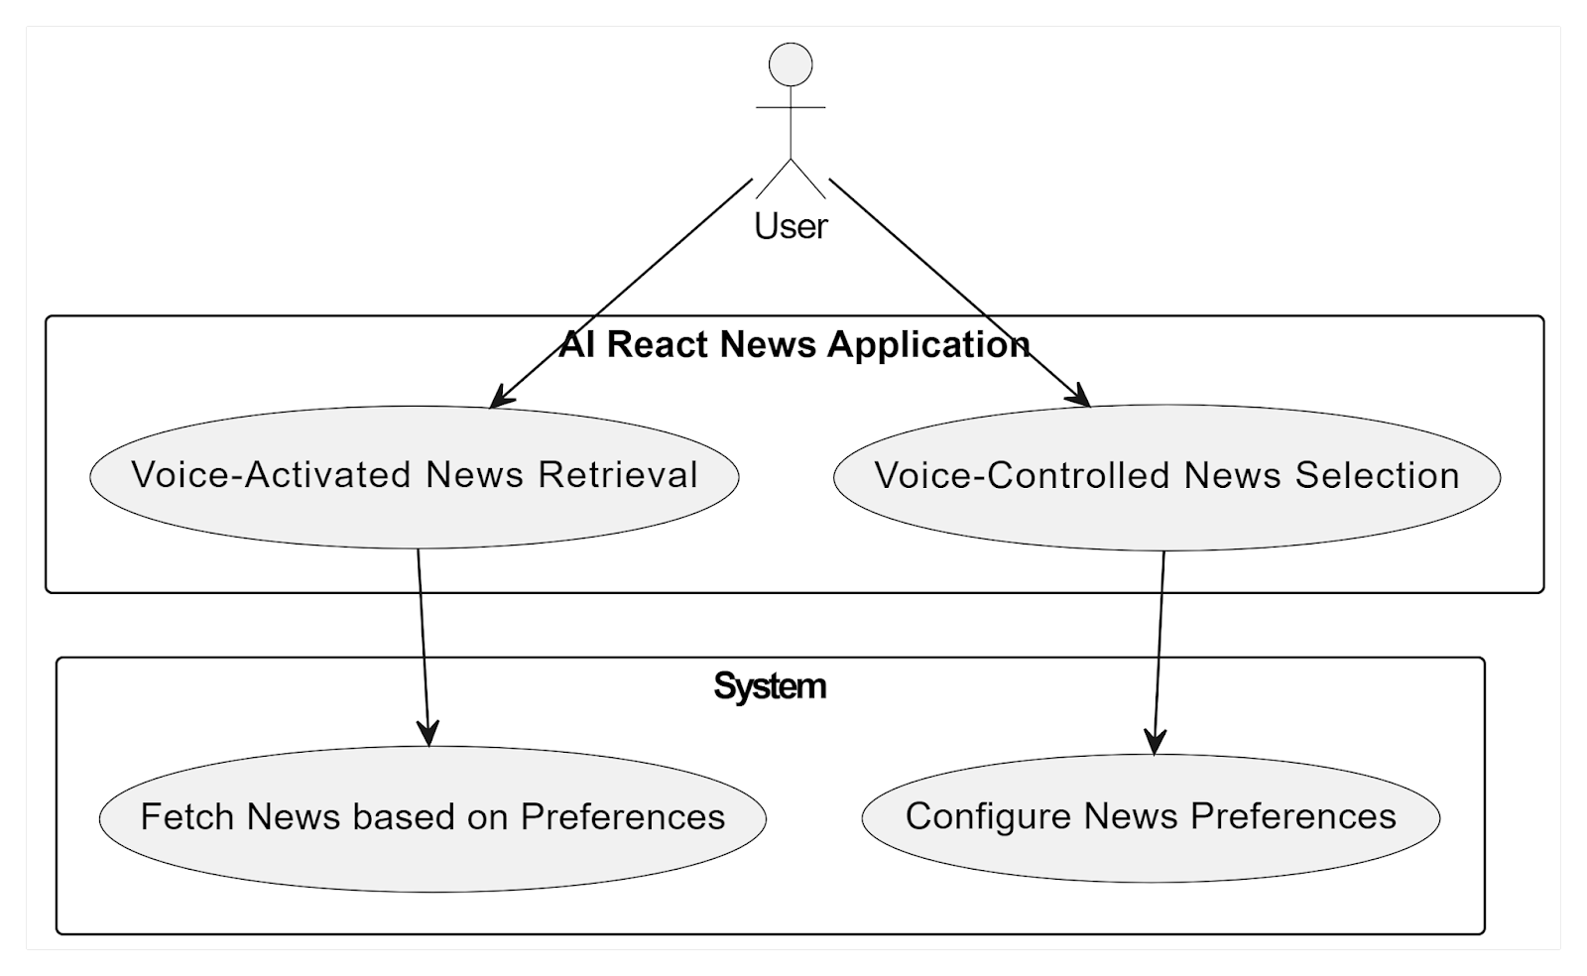
Use-Case Diagram
Voice-Controlled News Selection:
The application parses the speech and filters the latest headlines based on your requested topics, returning the relevant news to us.
Voice-Activated News Retrieval:
When the user asks for a particular headline using a phrase like “Open article number 3”, the application opens that article in a new tab.
Configure News Preferences:
The system parses the input from the user’s voice and queries the News API for the relevant information.
Fetch News based on Preferences:
The system retrieves the URL of the requested news article based on the parsed user selection.

Slide 11
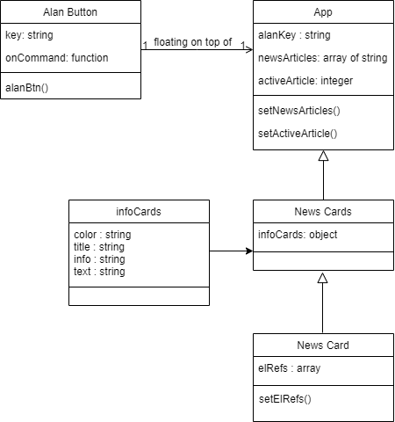
Class Diagram

Slide 12
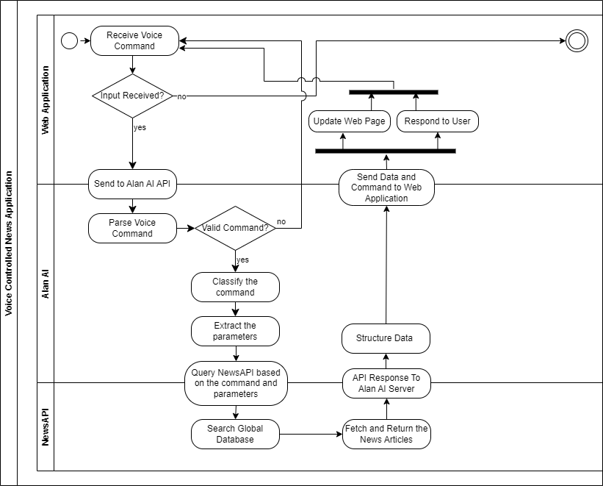
Activity Diagram

Slide 13
System Design
Data: There is no database because there is no need to store user preferences since they are asking for the most recent news according to the requested categories.
All the data is offloaded to the server so there is no need to worry about storing or handling data, and all the application’s work with data is ephemeral since it changes based on what the user asks for each time and though the author could create a database (if he wanted to store user history for each user) it is unnecessary.
Below is the data this application works with, fetched from the server based on user queries:
News Sources: Store information about available news sources.
News Topics: Store different news topics/categories.
News Articles: Store news content, including title, content, source, and topic.

Slide 14
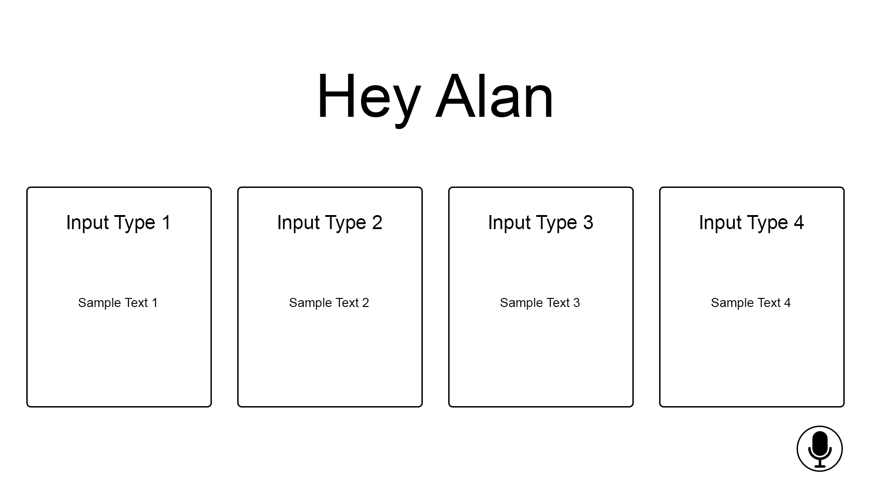
Input Design
The input UI design focuses on voice commands and user selections.
Voice Commands: Users issue voice commands for selecting news sources, and topics, and requesting news updates.
User Selections: Users can select news sources and topics using voice commands.

Slide 15
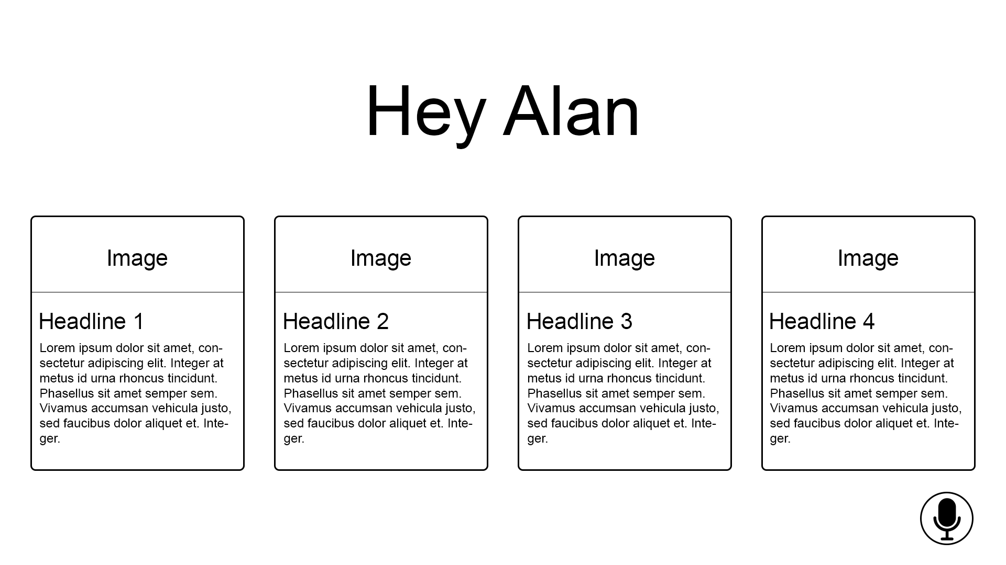
Output Design
The output UI design encompasses the presentation of news updates and user interactions.
News Updates: Display news articles based on user preferences, with options for reading more and skipping.
Interaction Feedback: Provide auditory and visual feedback for recognized voice commands and actions.

Slide 16
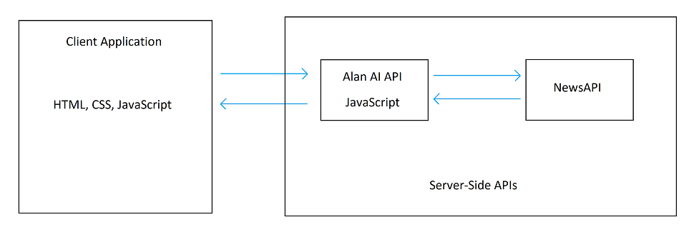
System Architecture
The system follows a client-server architecture:
Client (User Interface): Developed using React JS, HTML, and CSS, providing a responsive and user-friendly interface for users to interact with the application and issue voice commands.
Server: Manages the business logic, voice recognition, and database operations. Utilizes Alan AI for speech recognition and processing.

Slide 17
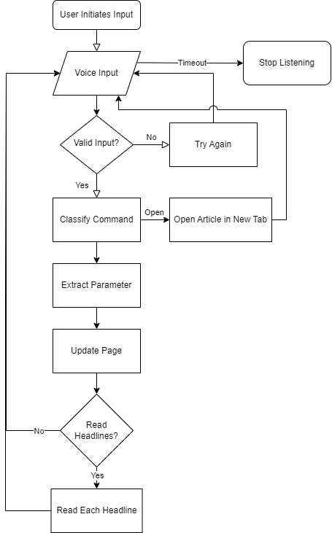
Program Flowchart

Slide 18
Source Code Listing
React
import React from 'react';
import NewsCard from '../NewsCard/NewsCard'
import {Grid, Grow, Typography} from '@material-ui/core';
import useStyles from './styles';
const infoCards = [
{ color: '#00838f', title: 'Latest News', text: 'Give me the latest news' },
{ color: '#1565c0', title: 'News by Categories', info: 'Business, Entertainment, General, Health, Science, Sports, Technology', text: 'Give me the latest Technology news' },
{ color: '#4527a0', title: 'News by Terms', info: 'Bitcoin, PlayStation 5, Smartphones, Donald Trump...', text: 'What\'s up with PlayStation 5' },
{ color: '#283593', title: 'News by Sources', info: 'CNN, Wired, BBC News, Time, IGN, Buzzfeed, ABC News...', text: 'Give me the news from CNN' },
];
function NewsCards({articles, activeArticle}) {
const classes = useStyles();
...
}

Slide 19
Source Code Listing
CSS
.App {
text-align: center;
}
.App-logo {
height: 40vmin;
pointer-events: none;
}
@media (prefers-reduced-motion: no-preference) {
.App-logo {
animation: App-logo-spin infinite 20s linear;
}
}
.App-header {
background-color: #282c34;
min-height: 100vh;
display: flex;
flex-direction: column;
align-items: center;
justify-content: center;
font-size: calc(10px + 2vmin);
color: white;
}

Slide 20
Source Code Listing
HTML
<!DOCTYPE html>
<html lang="en">
<head>
<meta charset="utf-8" />
<link rel="icon" href="%PUBLIC_URL%/favicon.ico" />
<meta name="viewport" content="width=device-width, initial-scale=1" />
<meta name="theme-color" content="#000000" />
<meta
name="description"
content="Web site created using create-react-app"
/>
<link rel="apple-touch-icon" href="%PUBLIC_URL%/logo192.png" />
…
</head>
…
</html>

Slide 21
Source Code Listing
JavaScript (Alan AI)
let savedArticles = [];
//News from Source
intent('Give me (the|) news from $(source* (.*))', (p) => {
let NEWS_API_URL = `https://newsapi.org/v2/top-headlines?apiKey=${API_KEY}`;
if(p.source.value) {
…
savedArticles = articles;
p.play({command:'newHeadlines', articles});
p.play(`Here are the (latest|recent) headlines from ${p.source.value}`);
p.play('Would you like me to read the headlines?');
p.then(confirmation);
})
});

Slide 22
Running of the Application

Slide 23
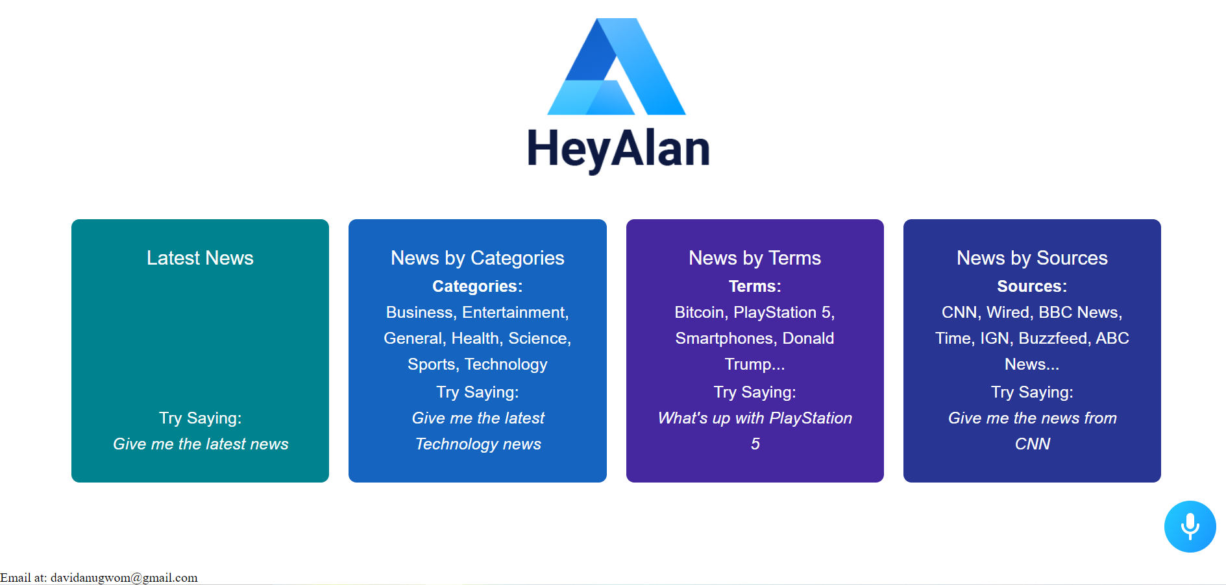
Home Page

Slide 24
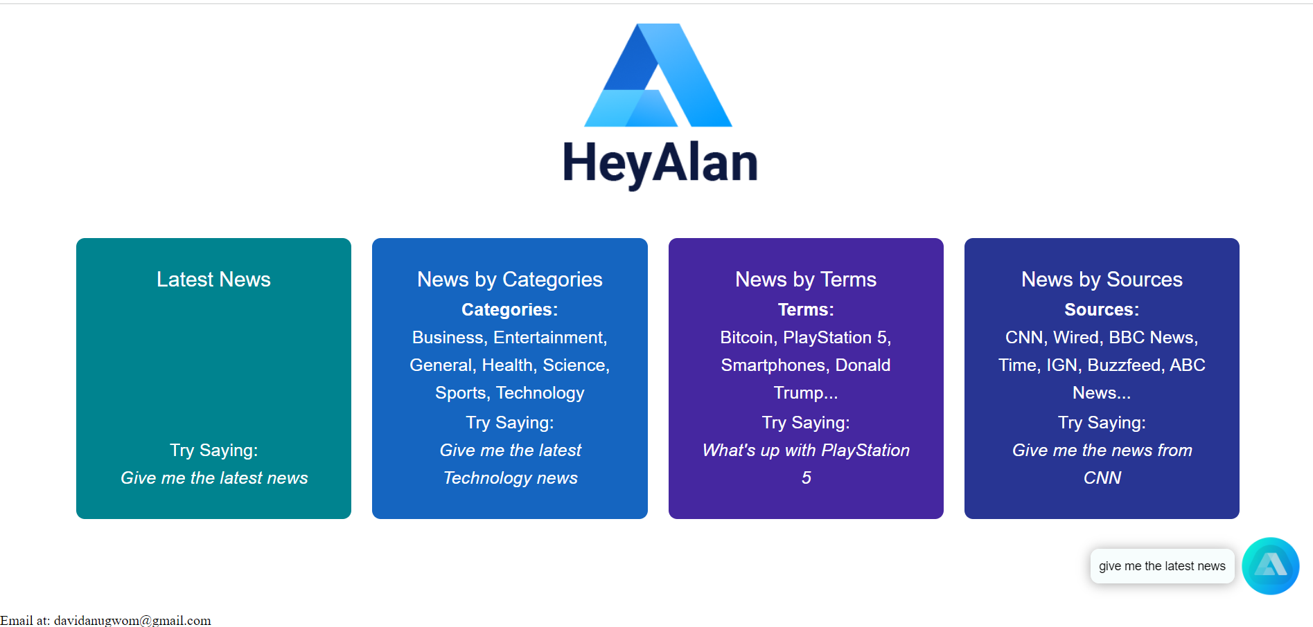
Latest News Input
"Give me the latest news"

Slide 25
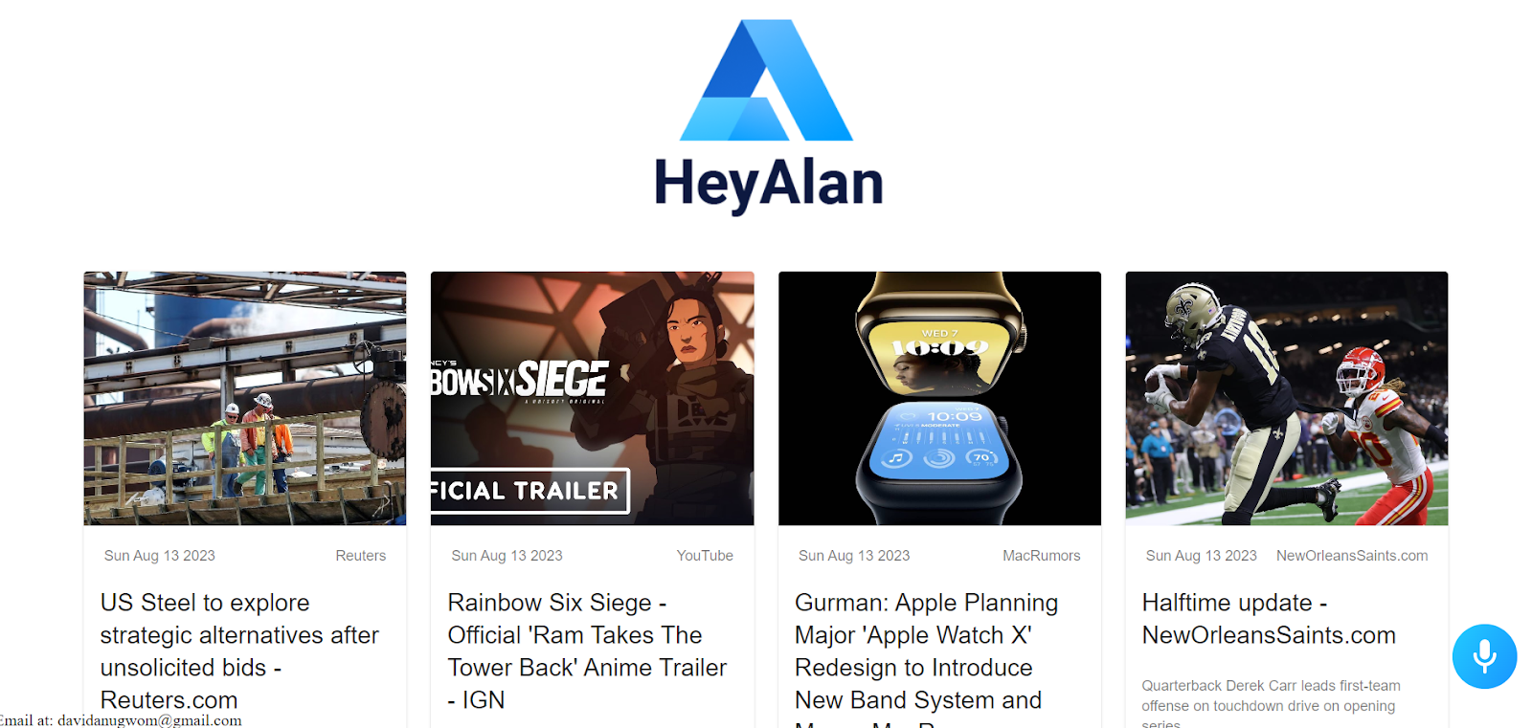
Latest News Output

Slide 26
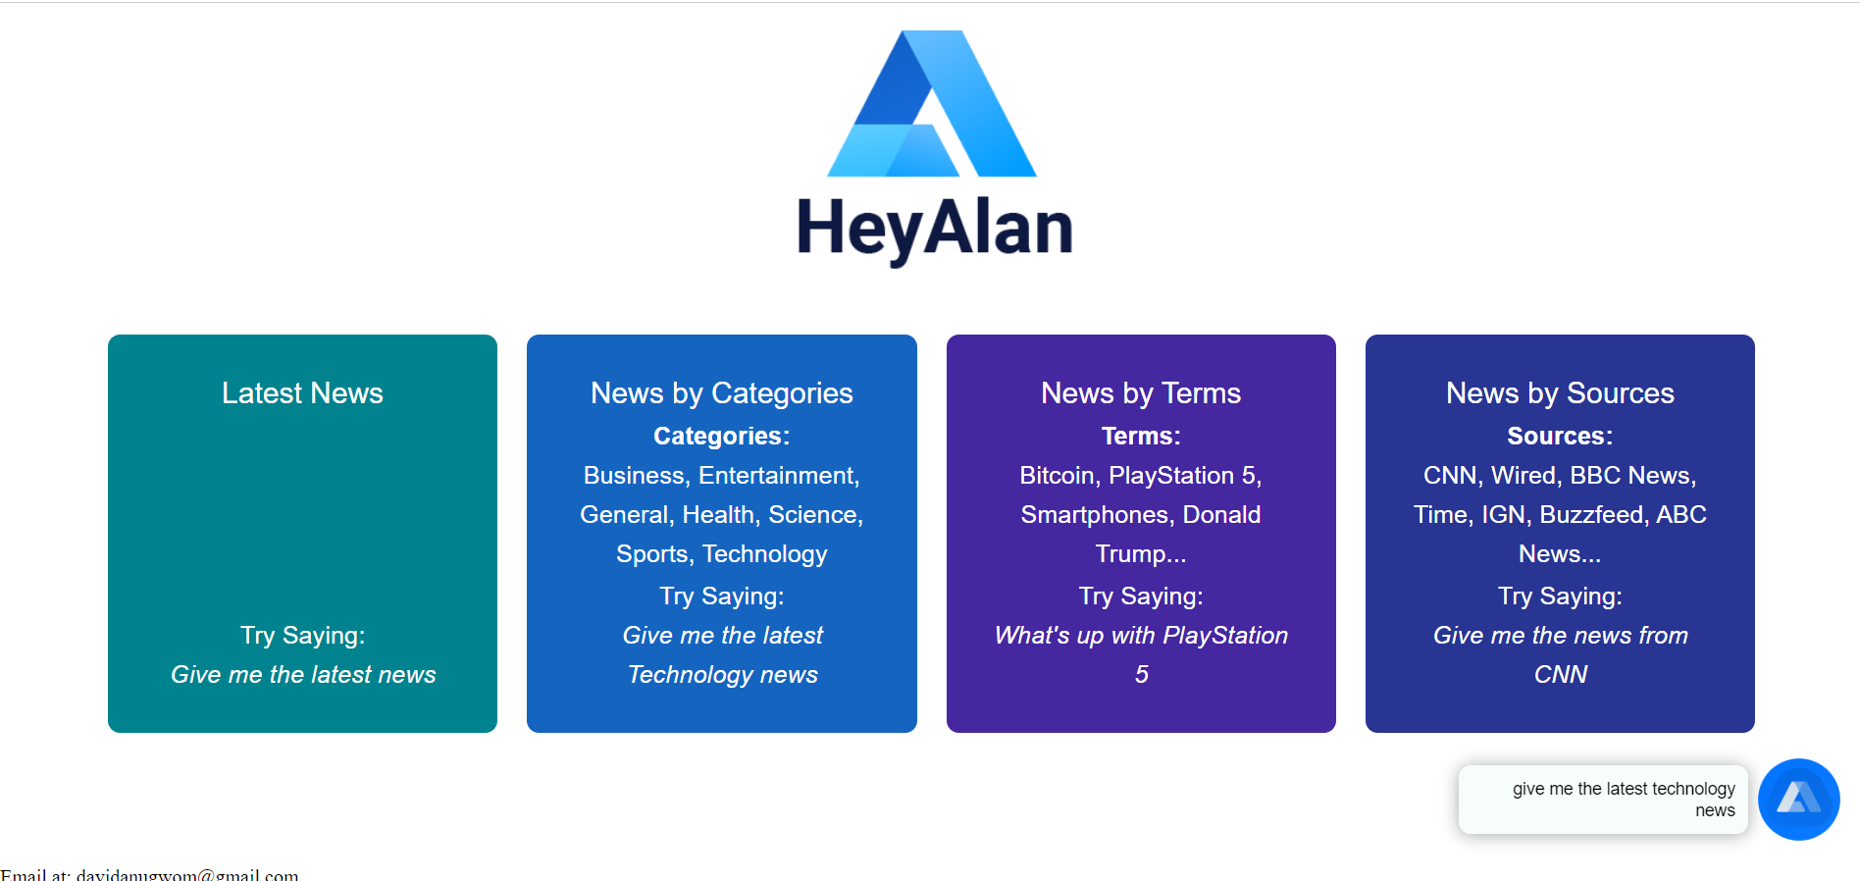
News Category Input
"Give me the latest Technology news"

Slide 27
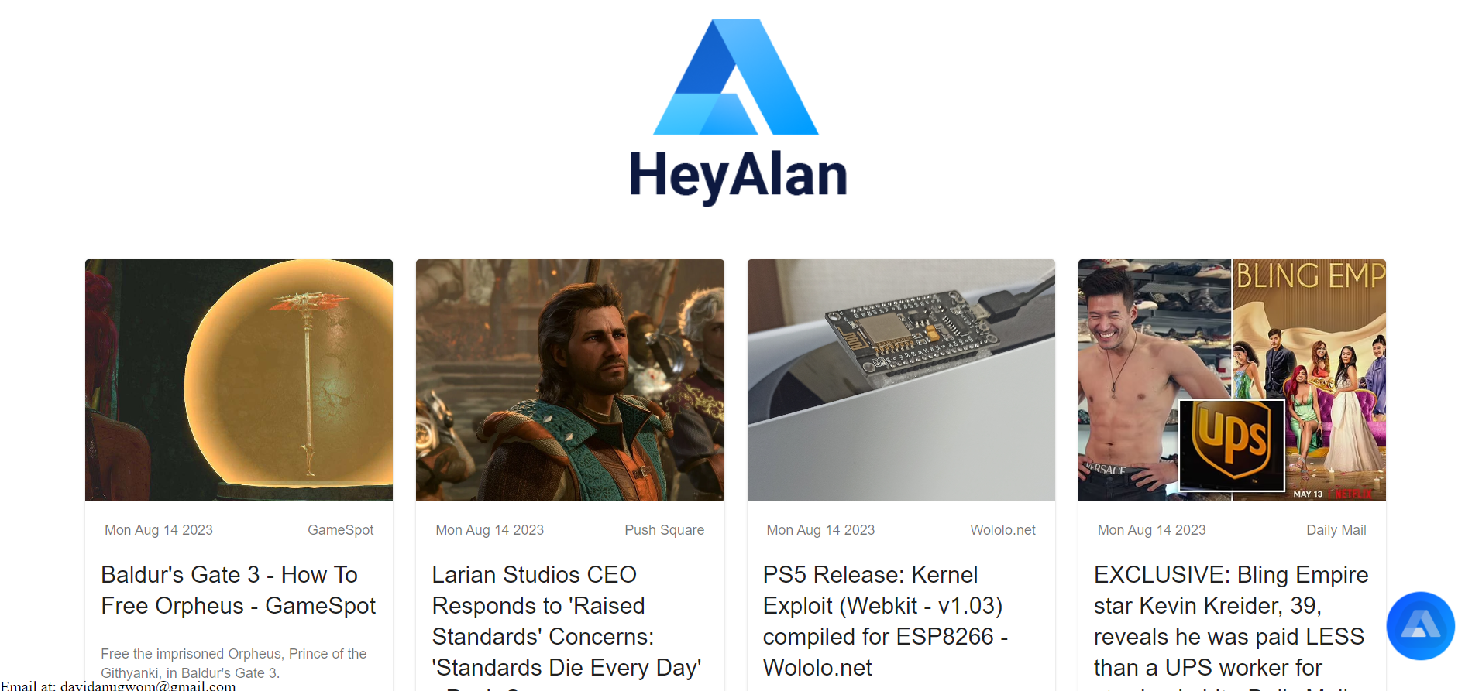
News Category Output

Slide 28
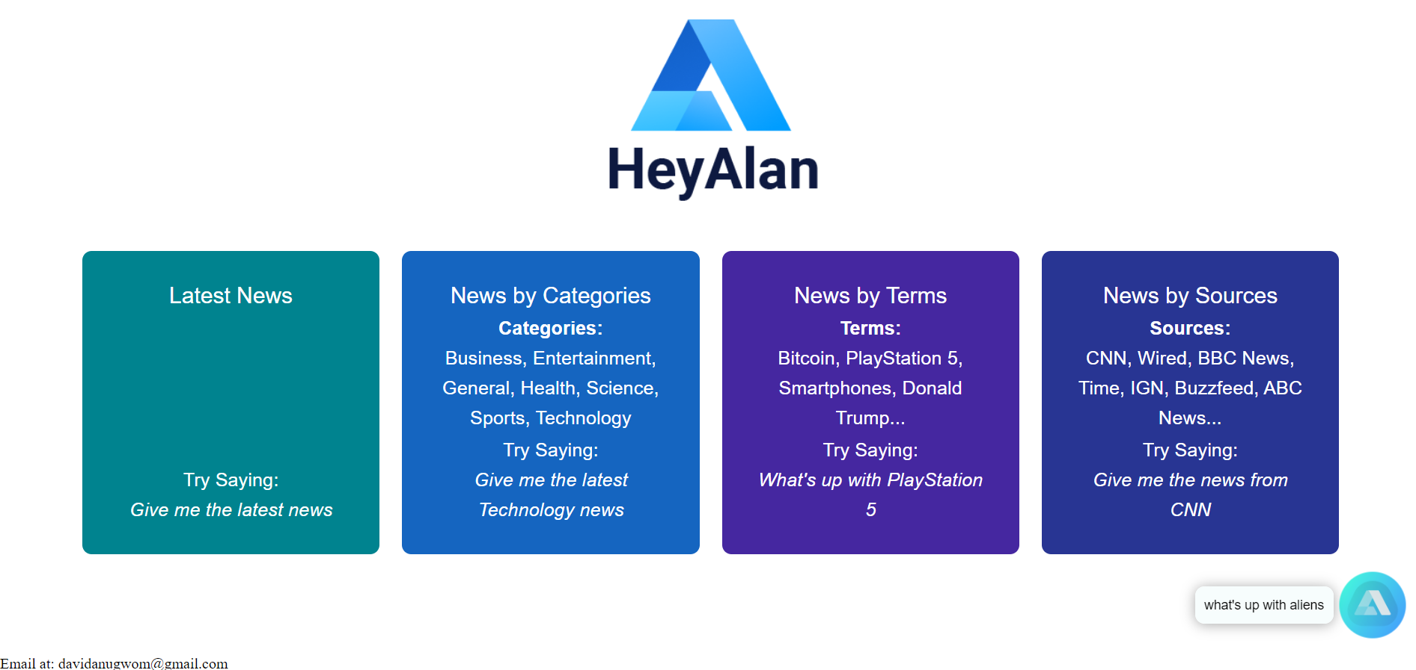
News Topic Input
"What's up with Aliens?"

Slide 29
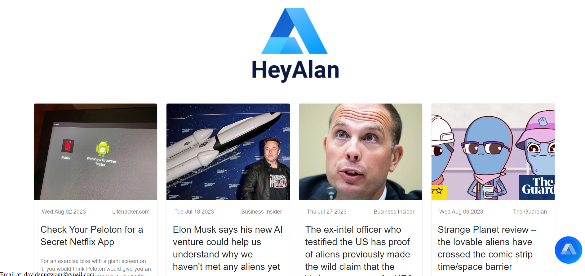
News Topic Output

Slide 30
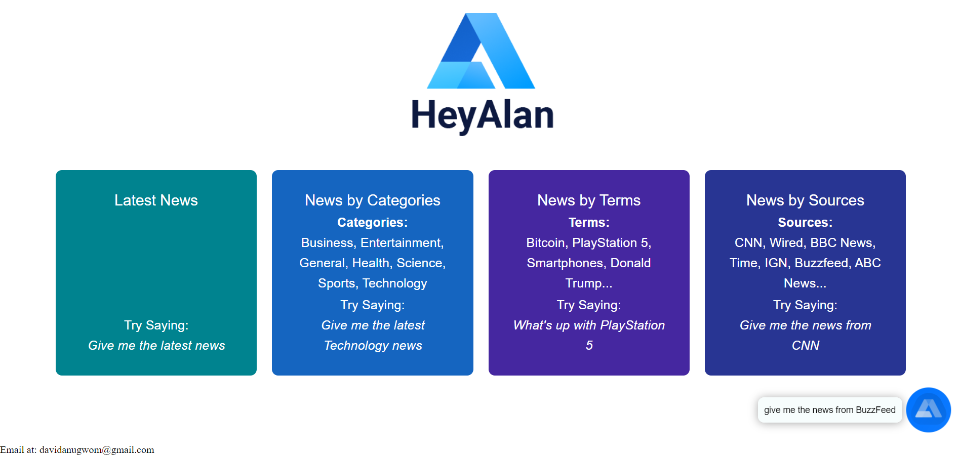
News Source Input
"Give me the latest news from BuzzFeed"

Slide 31
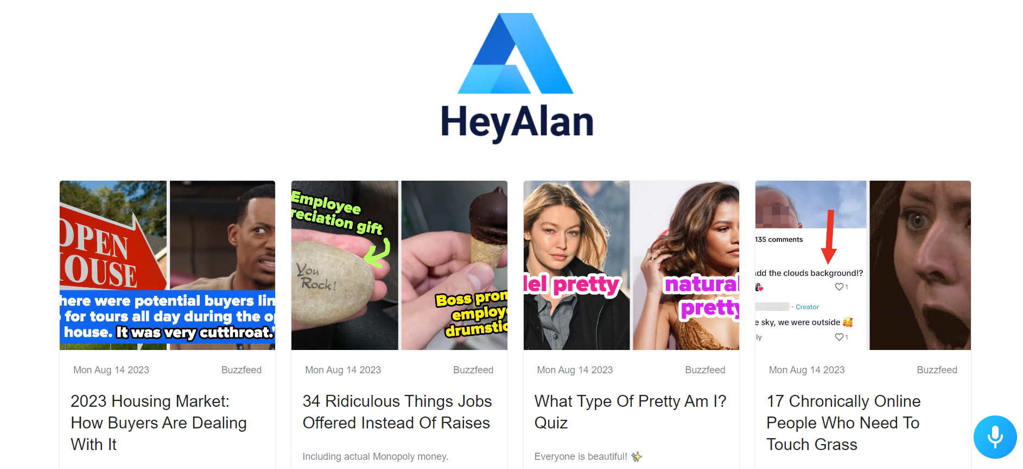
News Source Output

Slide 32
The End

